Slide 1
Apps and XAML, UWP and Xamarin.Forms
Rasmus Lystrøm
Associate Professor
ITU
rnie@itu.dk

Slide 2
Agenda
UI Frameworks for
XAML
Universal Windows Platform (UWP)
Xamarin.Forms
MVVM

Slide 3
UI Frameworks for C♯

Slide 4
UI Frameworks for C♯
Windows Forms
Windows Presentation Foundation
Universal Windows Platform
Xamarin.Forms
Blazor

Slide 5
Universal Windows Platform vs. Xamarin.Forms
UWP
Native Windows 10
HoloLens
Surface Hub
Surface Pro X
Xamarin.Forms
iOS
Android
Windows

Slide 6
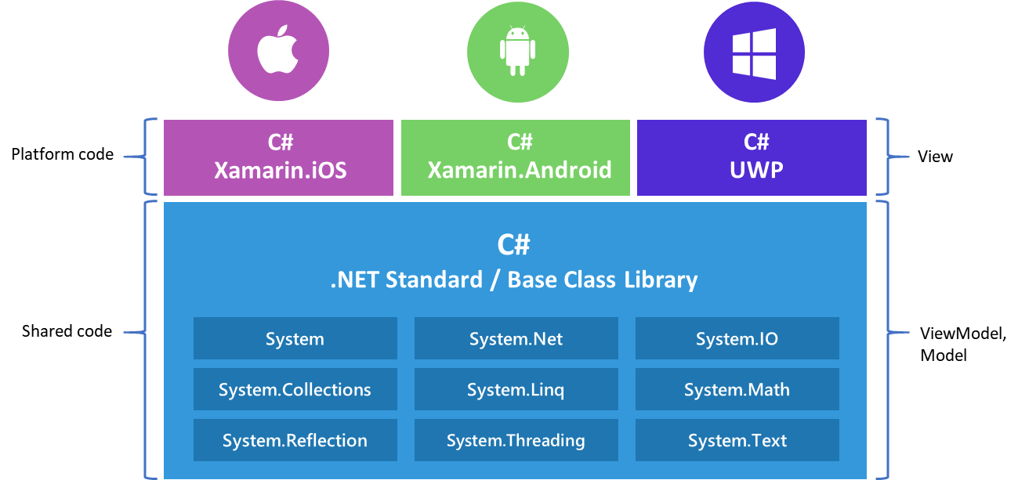
Xamarin Native vs Xamarin.Forms
Source: https://www.codemag.com/article/1911092

Slide 7
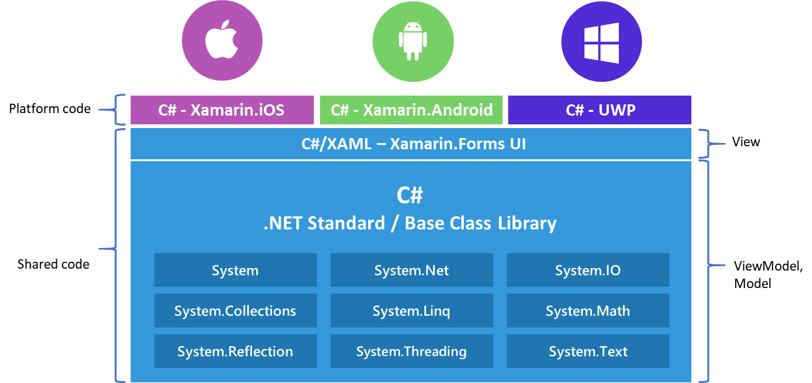
Xamarin Native vs Xamarin.Forms
Source: https://www.codemag.com/article/1911092

Slide 8
XAML

Slide 9

XAML = eXtensible Application Markup Language
Windows Desktop (WPF)
Windows Universal (anything)
Xamarin.Forms (iOS, Android, Windows)
Silverlight (web)

Slide 10
XAML
Markup language for declaratively designing and creating application UIs
XAML maps XML markup to objects in the .NET Framework
Every tag maps to a class and every attribute to a property
Markup and procedural code are peers in functionality and performance
Code and markup are both first class citizens
Consistent model between UI, documents, and media
Compiled to code

Slide 11
XAML Markup vs. Code
<Button Width="100">OK
<Button.Background>
Purple
</Button.Background>
</Button>
OK
var button = new Button();
button.Content = "OK";
button.Background = new SolidColorBrush(Colors.Purple);
button.Width = 100;

Slide 12
MainPage.xaml
<Page>
<Grid>
<StackPanel>
<Ellipse Name="Light" Fill="Red"
Height="200" Width="200" Margin="50" />
<Button Width="150"
Content="Change Lights"
HorizontalAlignment="Center"
Click="Button_Click" />
</StackPanel>
</Grid>
</Page>

Slide 13
MainPage.xaml.cs
namespace App
{
public sealed partial class MainPage : Page
{
public MainPage()
{
this.InitializeComponent();
}
private void Button_Click(object sender, RoutedEventArgs e)
{
var current = Light.Fill as SolidColorBrush;
if (current.Color == Colors.Red)
Light.Fill = new SolidColorBrush(Colors.Green);
else
Light.Fill = new SolidColorBrush(Colors.Red);
}
}
}

Slide 14
Xamarin.Forms
Demo

Slide 15
XAML + Code Behind
<StackPanel>
<Ellipse Name="Light" Fill="Red" Height="200" Width="200"
Margin="50" />
<Button Width="150" Content="Change Lights"
HorizontalAlignment="Center" Click="Button_Click" />
</StackPanel>
private void Button_Click(object sender, RoutedEventArgs e)
{
var current = Light.Fill as SolidColorBrush;
if (current.Color == Colors.Red)
{
Light.Fill = new SolidColorBrush(Colors.Green);
}
else
{
Light.Fill = new SolidColorBrush(Colors.Red);
}
}
Image source: http://lazergaze.tumblr.com/post/26333564955

Slide 16
MVVM

Slide 17
The Model-View-ViewModel Pattern
Separation of logic and presentation
Having event handlers in the code-behind is bad for testing, since you cannot mock away the view
Changing the design of the view often also requires changes in the code, since every element has its different event handlers
The logic is tightly bound to the view. It's not possible to reuse the logic in an other view

Slide 18
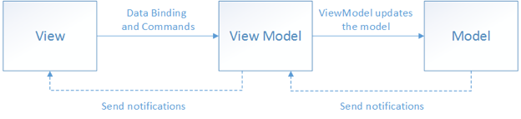
MVVM

Slide 19
MVVM
Demo

Slide 20
MVVM concepts
There is conceptually only ever one MODEL
Code in code-behind should be ABSOLUTELY MINIMAL
A ViewModel should ALWAYS implement INotifyPropertyChanged
A ViewModel may be used for more than one view

Slide 21
MVVM Design Patterns
Observer Pattern:
INotifyPropertyChanged
ObservableCollection<T>
MessagingCenter
Command Pattern:
ICommand

Slide 22
Xamarin.Forms / UWP gotchas
Mobile app must be set to Build and Deploy in solution configuration
If API and mobile app in same project: Use multiple startup projects
Source in C:\git or similar
HTTPS not possible for localhost:
Manifest: <application android:usesCleartextTraffic="true"></application>
Move app.UseHttpsRedirection(); to prod.
Run Web API with kestrel.
Don’t try/catch until you know what errors you want to handle!
Enable XAML Hot Reload

Slide 23

MVVM Tips
Don’t use frameworks:
MVVM Light
Template 10
Get your hands dirty first!
Image source: https://dirtyhands.wordpress.com

